Slide 1

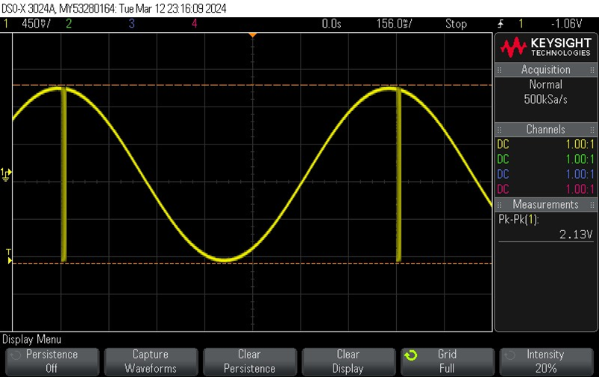
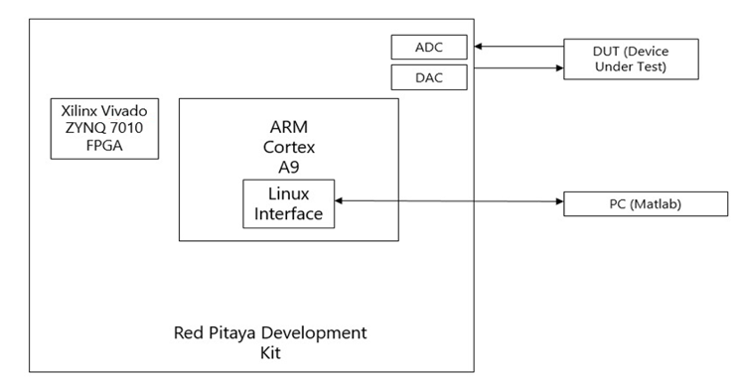
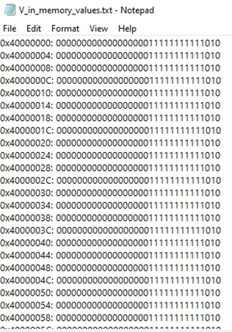
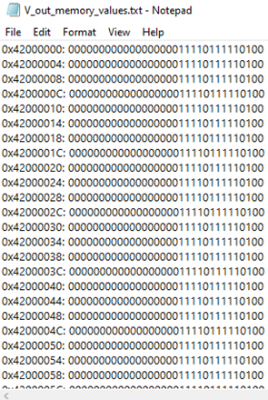
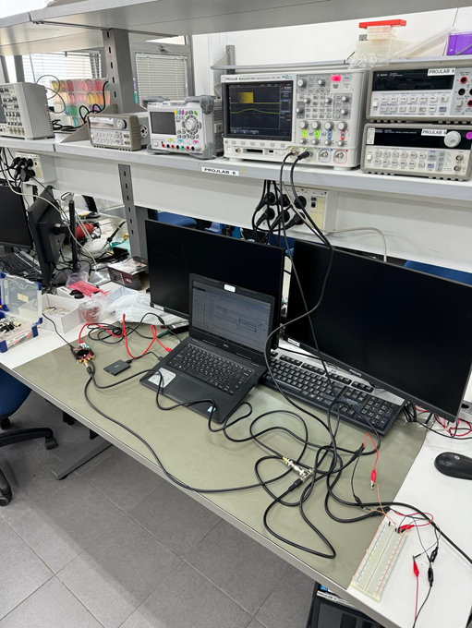
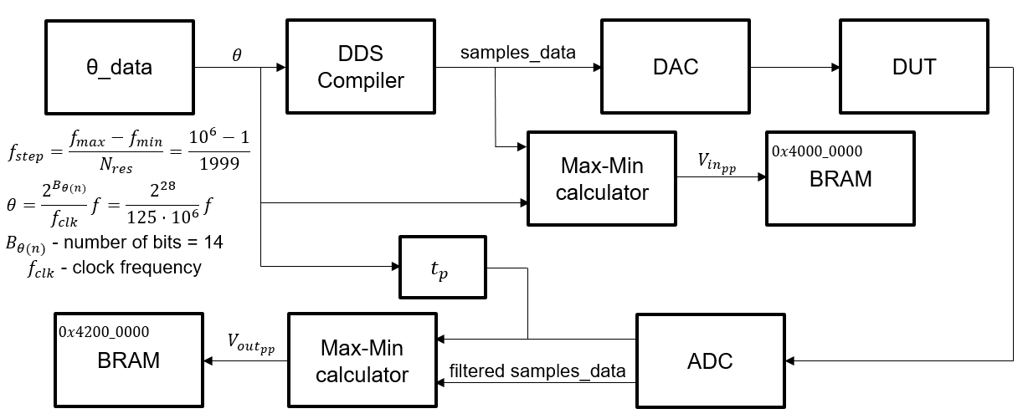
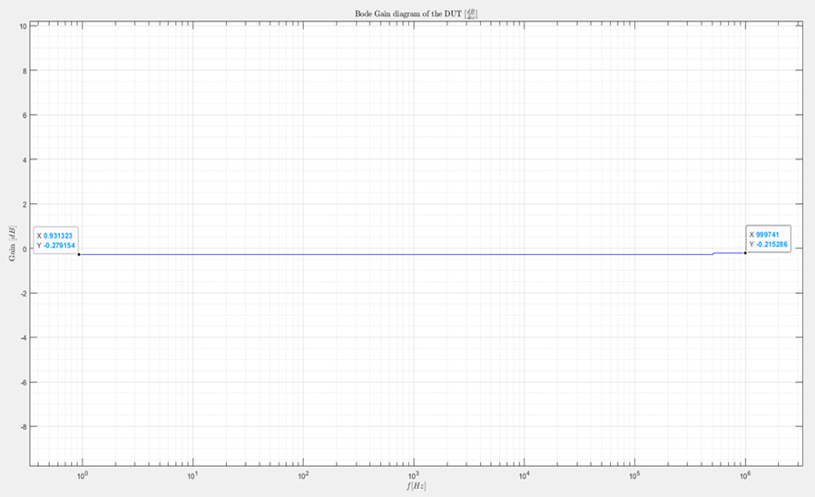
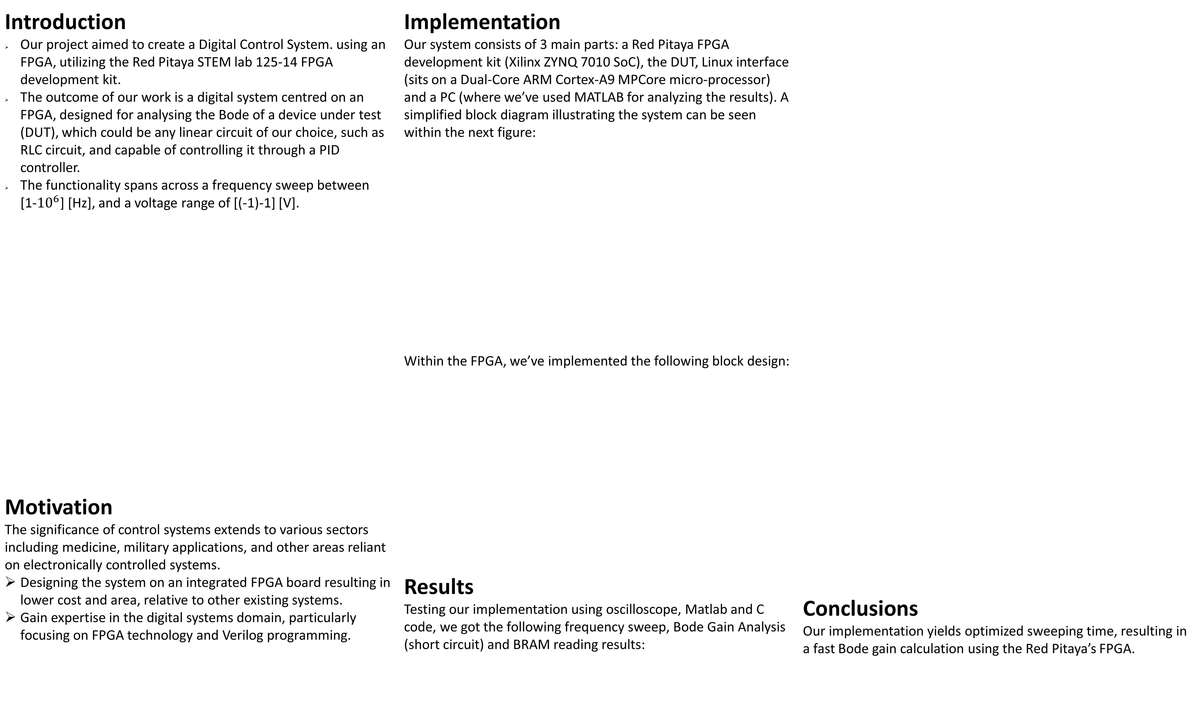
Digital Control System
Project Number: 22-2-1-2692
Names: Ronen Dvorkin, Omri Meron
Advisor: Meir Alon
Introduction Our project aimed to create a Digital Control System. using an FPGA, utilizing the Red Pitaya STEM lab 125-14 FPGA development kit. The outcome of our work is a digital system centred on an FPGA, designed for analysing the Bode of a device under test (DUT), which could be any linear circuit of our choice, such as RLC circuit, and capable of controlling it through a PID controller. The functionality spans across a frequency sweep between [1-${10}^{6}$] [Hz], and a voltage range of [(-1)-1] [V]. Motivation The significance of control systems extends to various sectors including medicine, military applications, and other areas reliant on electronically controlled systems. Designing the system on an integrated FPGA board resulting in lower cost and area, relative to other existing systems. Gain expertise in the digital systems domain, particularly focusing on FPGA technology and Verilog programming. | Implementation Our system consists of 3 main parts: a Red Pitaya FPGA development kit (Xilinx ZYNQ 7010 SoC), the DUT, Linux interface (sits on a Dual-Core ARM Cortex-A9 MPCore micro-processor) and a PC (where we’ve used MATLAB for analyzing the results). A simplified block diagram illustrating the system can be seen within the next figure: Within the FPGA, we’ve implemented the following block design: Results Testing our implementation using oscilloscope, Matlab and C code, we got the following frequency sweep, Bode Gain Analysis (short circuit) and BRAM reading results: | Conclusions Our implementation yields optimized sweeping time, resulting in a fast Bode gain calculation using the Red Pitaya’s FPGA.

